Slide 1
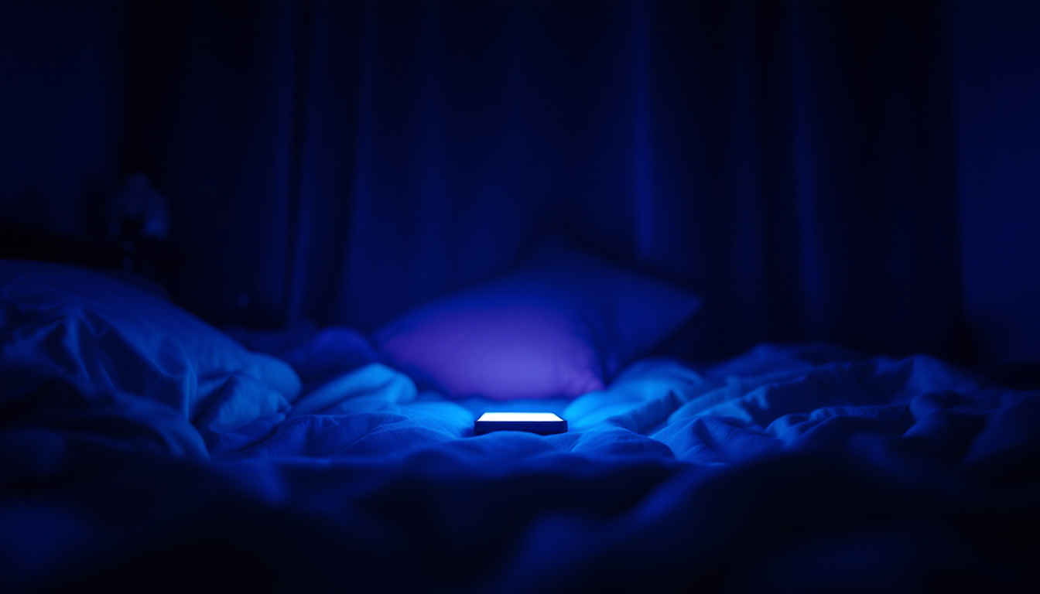


MENTAL HEALTH RISK ANALYTICS
Data Engineering | Lakehouse Architecture | Delta Optimization | Governance | Analytics | Machine Learning | AI Storytelling | Social Impact
Engineered by: PARVEEN PATEL
Role: Data Enthusiast

Slide 2
Problem Definition:
Predict mental health risk (anxiety/depression severity) based on social media behavior and lifestyle patterns and understand how risk factors differ between males and females.
Why AI (Not Rules)? Because:
Mental health risk is influenced by multiple interacting factors.
Simple thresholds (like “screen time > 6 hrs.”) miss complex relationships
ML can learn nonlinear patterns between sleep, usage time, content type, and psychometric scores.

Slide 3
Data Understanding & Feature Engineering:
Data Understanding:
The dataset represents 8,000 social media users with detailed digital behavior and mental health indicators.
Each record combines:
  Demographics (Age, Gender)
  Usage behavior (screen time, activity type, late-night usage)
  Psychometric scores (GAD-7 for anxiety, PHQ-9 for depression)
The data is synthetic but scientifically grounded, generated using psychological research patterns.
Designed specifically for gender-based comparative analysis and behavioral risk modeling.

Slide 4
Key observations from raw data:
Mental health impact is behavior-driven, not caused by a single variable.
Late-night usage and reduced sleep appear frequently with higher depression scores.
Passive content consumption and social comparison are common anxiety triggers.
Feature Engineering (Silver Layer) : Cleaned raw data by: Removing duplicates and handling missing values in critical numerical fields.

Slide 5
Created behavioral risk features to translate raw usage into meaningful signals:
Engineered Features:
High_Screen_Time: Flagged users spending more than 6 hours daily on screens.
Sleep_Deprived: Identified users sleeping less than 6 hours.
LateNight_Sleep_Risk: Combined late-night activity with sleep deprivation.
Passive_Usage_Risk: Captured risk from passive scrolling behavior.
Social_Comparison_Risk: Represented exposure to comparison-driven content.
High_Mental_Health_Risk (Target): Flagged users with moderate-to-severe anxiety or depression scores.
These features converted raw digital behavior into interpretable mental health risk signals.

Slide 6
AI Innovation & Insight Generation:
What makes this project “AI” and not just SQL?
Instead of only reporting mental health statistics, I designed behavioral risk signals from raw social media usage data.
I transformed daily habits (screen time, sleep, late-night usage, activity type) into risk indicators.
These features helped uncover hidden behavioral patterns, not obvious from raw data alone.
Key AI-driven insights generated:
High screen time + sleep deprivation strongly correlates with higher anxiety and depression scores.
Late-night social media usage amplifies mental health risk.
Passive consumption and social comparison increase anxiety levels.
Gender-based risk distribution highlights different behavioral impacts.
Innovation here is feature engineering + insight generation from behavior, not just prediction.

Slide 7
Model Selection & Technical Reasoning:
Why this model? Why not something else?
I chose Random Forest Classifier because:
  It handles non-linear relationships well.
  Works effectively with behavioral and categorical features.
  Is robust to noise and feature interactions.
Technical decisions:
Used Spark ML Pipeline for scalability.
Feature vectorization using Vector Assembler.
Binary classification: High Mental Health Risk vs Not High Risk.
Trained directly on Gold ML features table.
The focus was interpretability + scalability, not just accuracy.

Slide 8
Training, Evaluation & Metrics:
How I validated the model?
Model training and experiments were tracked using Mlflow and I logged key evaluation metrics:
Accuracy –Mental health predictions require balanced evaluation.
AUC –AUC helps avoid misleading accuracy in imbalanced datasets.
Confusion Matrix – false positives vs false negatives- supports explainability and trust.
Outcome:
Model achieved stable performance.
Predictions stored in a Gold prediction table.
Metrics and model version fully reproducible via Mlflow.

Slide 9
Database ↔ AI Workflow (Lakehouse Integration):
Data flows through:
  Bronze → Raw ingestion (Delta).
  Silver → Cleaned & feature-engineered data.
  Gold → Analytics tables & ML-ready datasets.
AI integration: ML model reads directly from Gold Delta tables.
Predictions written back to Gold prediction table.
Same data serves: SQL Analytics | Dashboards | ML training | Model inference.
This avoids data duplication and ensures single source of truth.

Slide 10
Business Impact & Practical Use:
Why this project matters in the real world?
Enables early detection of mental health risk based on behavior and helps platforms:
  Identify high-risk users proactively.
  Design targeted well-being interventions.
  Monitor impact of platform usage patterns.
Practical applications:
Mental health monitoring dashboards.
Risk-based user segmentation.
Responsible AI use in social platforms.

Slide 11

Scalable & production-ready:
Automated jobs.
Governed data access via Unity Catalog.
ML lifecycle managed with Mlflow.

